Slide 1

ANUMOL UNNI - PHDU

Slide 2
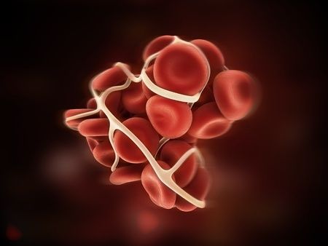
VTE RISK ASSESSMENT

Slide 3
Outlines
Define venous thromboembolism (VTE)
state the
Risk factor of the VTE
Discuss importance of
appropriate prescribing of prophylaxis
VTE risk assessment
Demonstrate how to assess VTE risk
Roles and responsibilities of health care providers
References

Slide 4
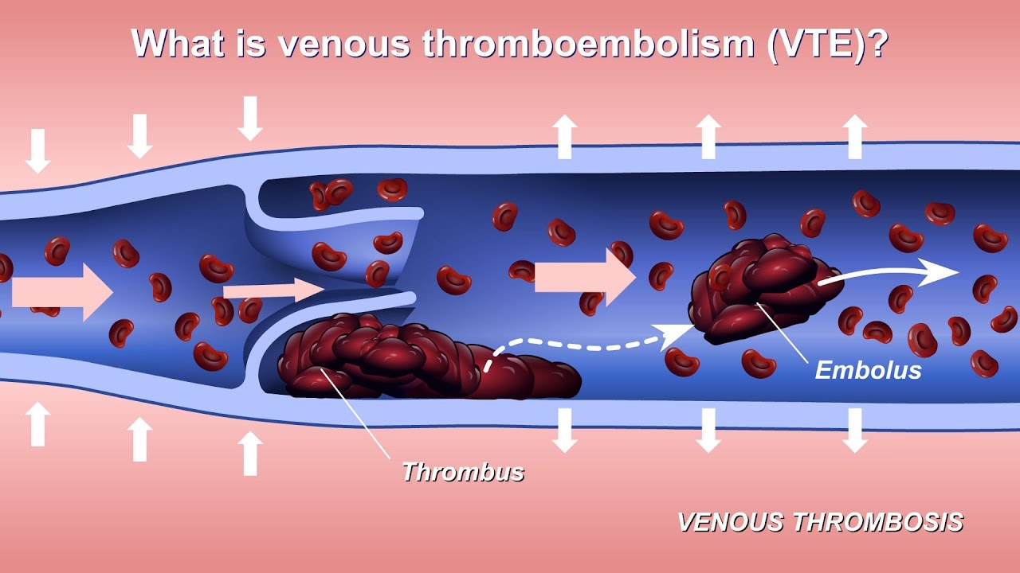

Slide 5
Venous Thromboembolism
VTE = Deep vein thrombosis (DVT) and/or pulmonary embolism (PE)
differences | Pulmonary embolism | Deep vein thrombosis
location | Occurs after DVT dislodges and travels to the lungs | Occurs in deep veins (most commonly in legs and groin)
Sign and symptoms | unexplained shortness of breath, chest pain, arrhythmia, tachycardia, low BP, | post-thrombotic syndrome’ (PTS), which can cause chronic symptoms including leg pain, swelling, redness, and ulceration.

Slide 6
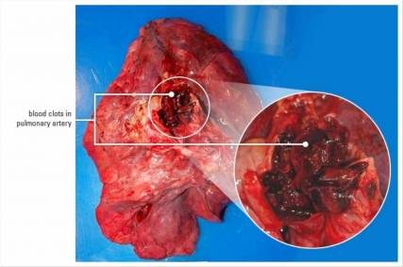
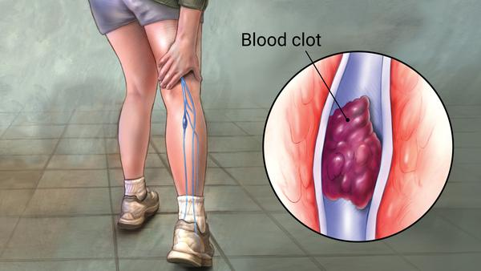

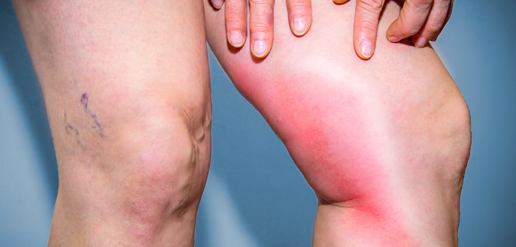

Slide 7
RISK FACTOR
Every risk factor can be derived from Virchow's triad
Virchow's triad: categories of factors contributing to blood clot formation
Stasis
Alteration in normal blood flow
Endothelial Injury
Injury or trauma to the inside of the blood vessel
Hypercoagulability
Alternation in the constitution of blood causing blood to clot more easily

Slide 8
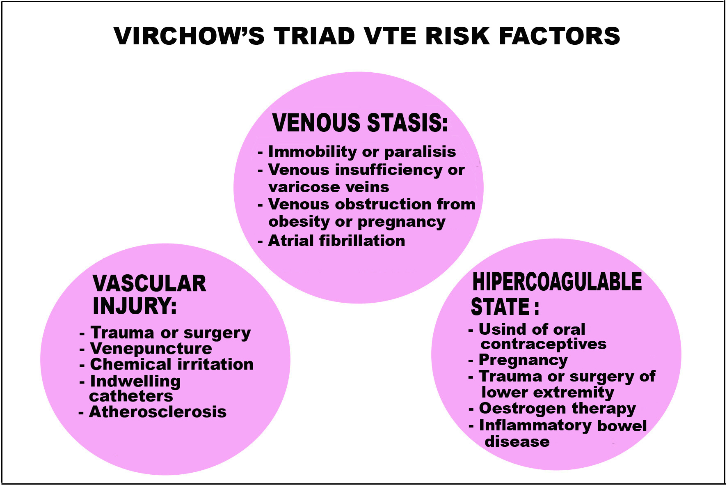
Continue

Slide 9
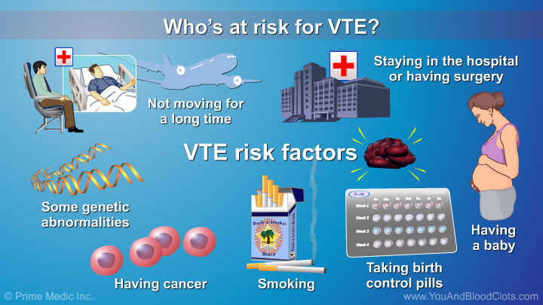

Slide 10
VTE PREVENTION
VTE prevention processes are comprised of two main aspects:
Prescribing Appropriate Prophylaxis
Risk assessment
VTE prevention

Slide 11
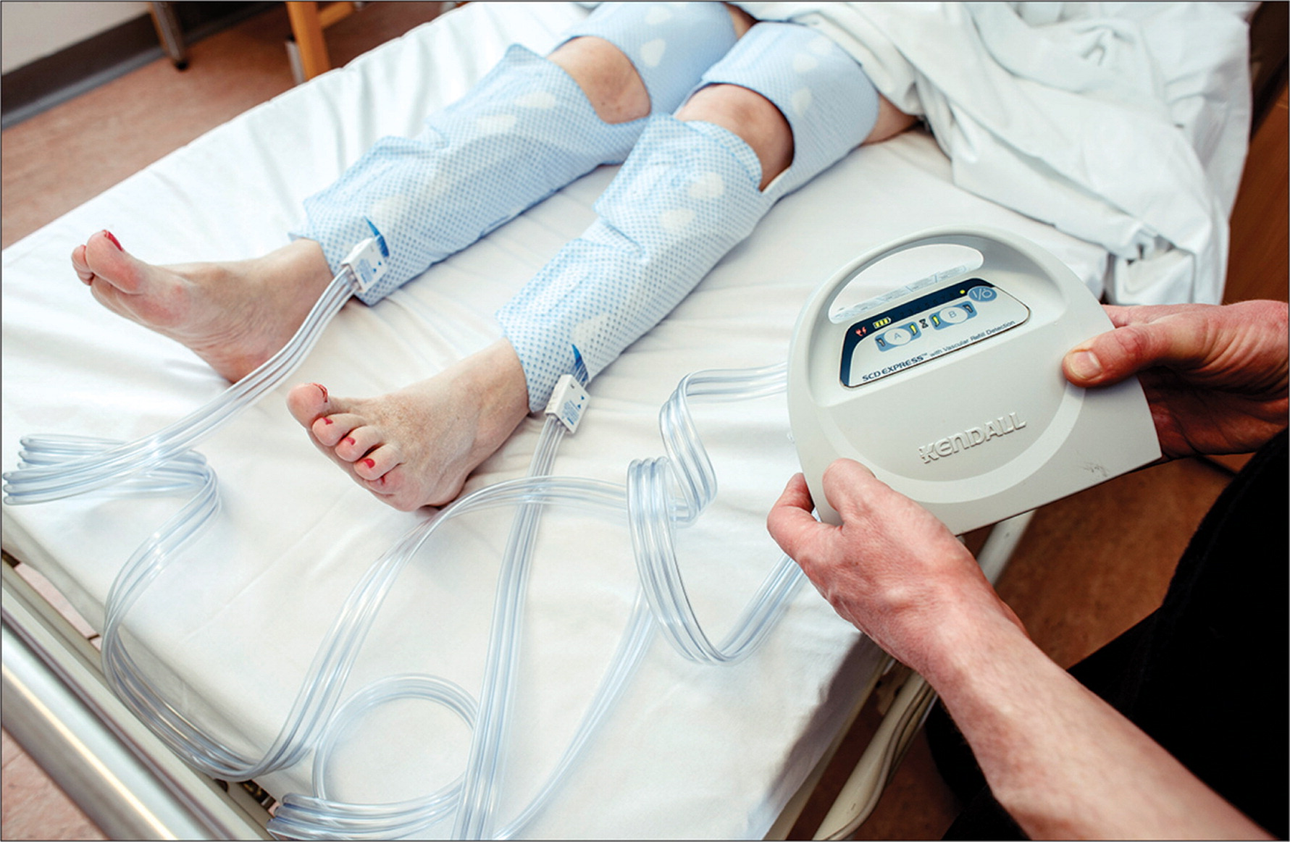
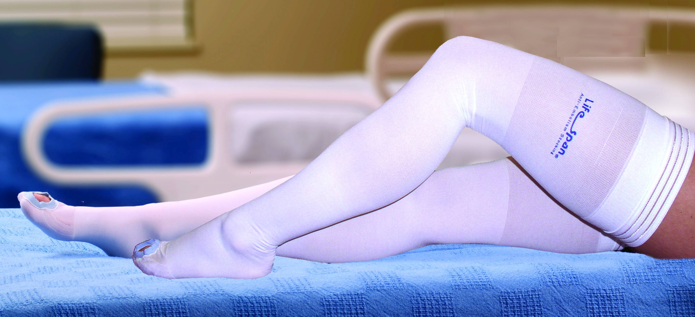
Prescribing Appropriate Prophylaxis
Mechanical prophylaxis
graduated elastic compression stockings (GEC)
intermittent pneumatic compression devices (IPC)

Slide 12
CONTRINDICATION TO MECHANICAL PROPHYLAXIS
Leg ulcer
Skin ulceration
Lower leg trauma
Morbid obesity (where correct fitting of stocking cannot be achieved)
Massive leg oedema or pulmonary oedema due to CCF
Stroke patients (avoid compression stockings)

Slide 13
Pharmacological prophylaxis
Drug class | Agent
Unfractionated heparin | Unfractionated heparin | Preferred in patients with renal impairment
LMWH | Enoxaparin Dalteparin | Most commonly used agents Require dosage adjustment in renal impairment
Factor Xa inhibitors | Fondaparinux | Alternative for prophylaxis in post- hip or knee replacement and hip fracture surgery
Direct thrombin inhibitors | Dabigatran | Alternative for prophylaxis in prophylaxis post- hip or knee replacement
Heparinoid | Danaparoid | Used in heparin-sensitivity or HIT

Slide 14
Contraindication to pharmacological prophylaxis
Active bleeding
Thrombocytopenia (platelets < 50 x 10⁹/L)
End stage liver disease (INR > 1.5)
Treatment with therapeutic anticoagulant e.g. warfarin with INR > 2
Severe trauma to head or spinal cord, with haemorrhage in last 4 weeks

Slide 15
VTE risk assessment
Who should be assessed?
ALL patients admitted into Critical area
We must consider….
Anticoagulant benefits bleeding risks

Slide 16
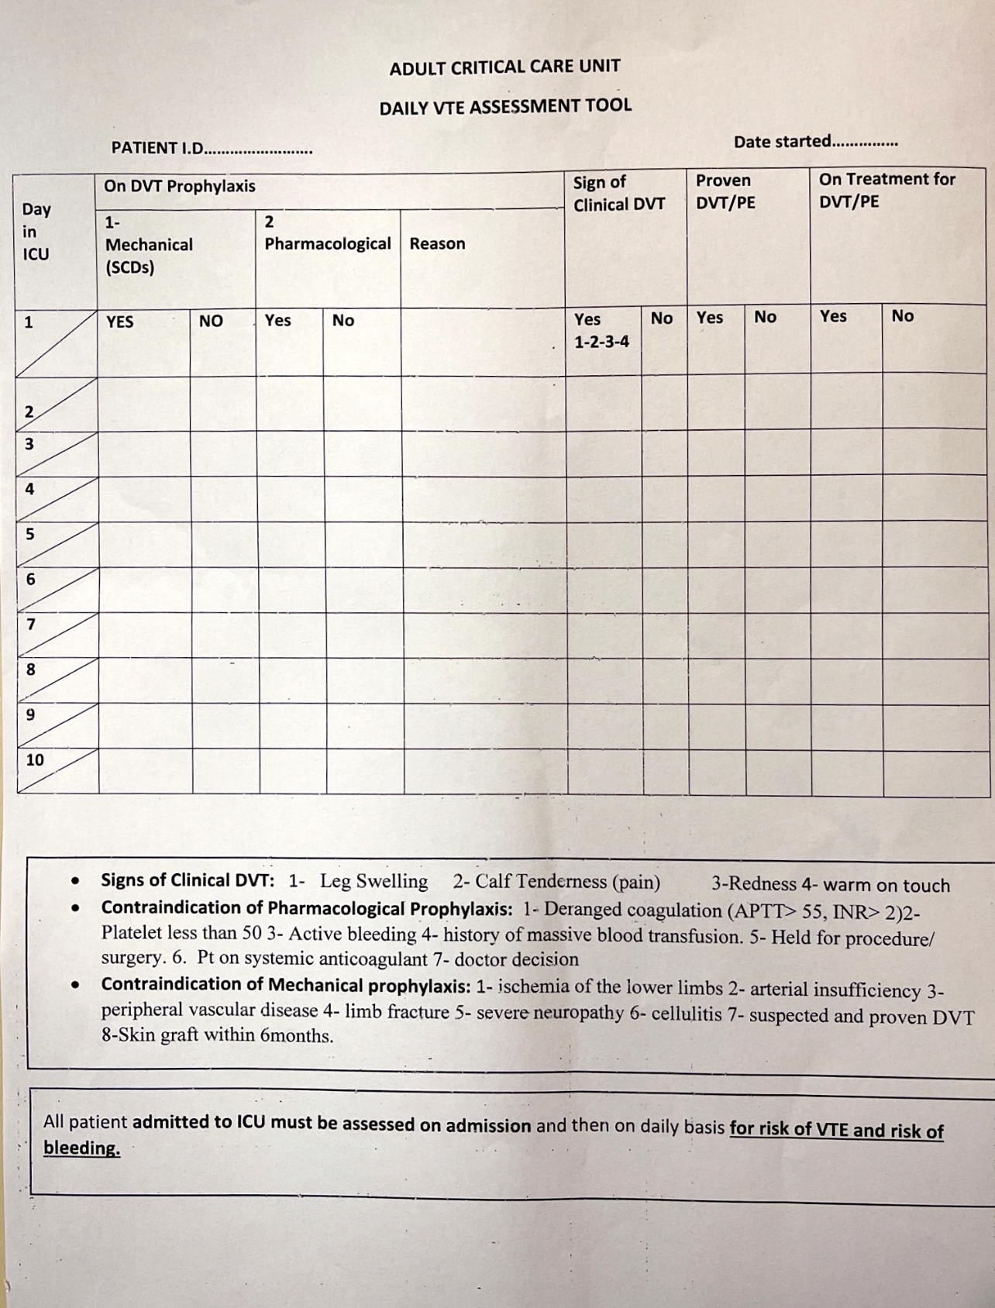

Slide 17
ROLES&RESPONSIBILITIES
Major nursing intervention is provide comfort to the patient.
Elevation of the affected extremity.
Graduated compression stockings.
Warm application.
For Pulmonary Embolism managing pain and relieving anxiety.
Provide Oxygen Therapy.
Preventing the formation of a thrombus (by ambulation and passive leg exercises).
Trombolytic therapy.
Blood thinners.

Slide 18
References
Al Harbi , S. Khedr, M. Al-Dorzi, H.M. Tlayjeh, H. Rishu, A. Arabi, Y. The association between statin therapy during intensive care unit stay and the incidence of venous thromboembolism: a propensity score-adjusted analysis. BMC Pharmacology and Toxicology14(57), pp. 1-6.
Achaibar, K and Waldmann, C. 2015. Prevention of venous thromboembolism in the critically ill patient. Journal of the Intensive Care Society 16(3), pp. 199–201.
Arabi YM, Khedr M, Dara SI, et al. 2013. Use of intermittent pneumatic compression and not graduated compression stockings is associated with lower incident VTE in critically III patients: a multiple propensity scores adjusted analysis. Chest 144 (10, pp. 152–159.
Dennis, M. Sandercock, P. Reid, J. Graham, C. Forbes, J. Murray. G. 2013. Effectiveness of intermittent pneumatic compression in reduction of risk of deep vein thrombosis in patients who have had a stroke (CLOTS 3): a multicentre randomised controlled trial. Lancet382(9891), pp.516-24.

Slide 19
Malato, A. Dentali, F. Siragusa, S. Fabbiano, F. Kagoma, Y. Boddi, M. Gensini, G. Peris, A. Crowther, M. Napolitano, M. 2015. The impact of deep vein thrombosis in critically ill patients: a meta-analysis of major clinical outcomes. Blood Transfus13(1), pp. 559-68
Minet, C. Potton, L. Bonadona, A. Roy, R. Ar Somohano, Lugosi, M. Cartier, J. Ferretti, G. Schwebel, C. Timsit, J. 2015. Venous thromboembolism in the ICU: main characteristics, diagnosis and Thromboprophylaxis. Critical care 19(287), pp. 1-9.
Miri1, M. Goharani1, R. Sistanizad, M. 2017. Deep Vein Thrombosis among Intensive Care Unit Patients; an Epidemiologic Study . Emergency 5(1), pp.1-5.
Sud1,S. Mittmann, N. Cook, D. Geerts, W. Chan, B. Dodek, P. Gould, M. Guyatt, G. Arabi, Y. Fowler, R. 2011. Screening and Prevention of Venous Thromboembolism in Critically Ill Patients. Am J Respir Crit Care Med 184. pp, 1289–1298,

Slide 20


